Slide 1
Astrophysical origin
Of the 35Msun peak: proposed channels

Slide 2
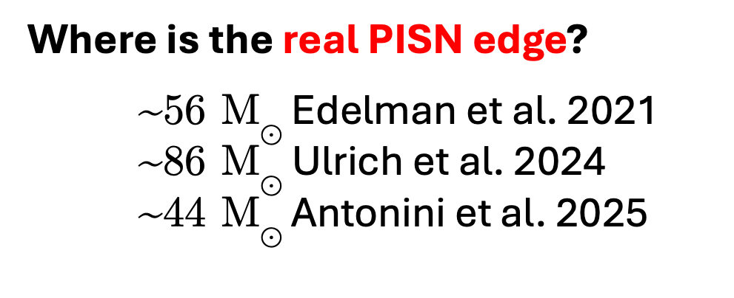
PISN scenario 1: pile up
The location at 35 is at odds with C(alpha,gamma)O values (by multiple sigma off from other observations)
Recent studies consistently place this boundary at a much higher value of ~60^{+32}_{-14} Msun (Mehta2022,Farag2022,Shen2023).
shifting the PISN gap to align with the GW-detected peak would require a rate of hydrogen-less super-luminous supernovae that is in tension with supernova observations (Hendriks2023).
Where is the real PISN edge?
~56 M$⊙$ Edelman et al. 2021
~86 M$⊙$Ulrich et al. 2024
~44 M$⊙$ Antonini et al. 2025

Slide 3
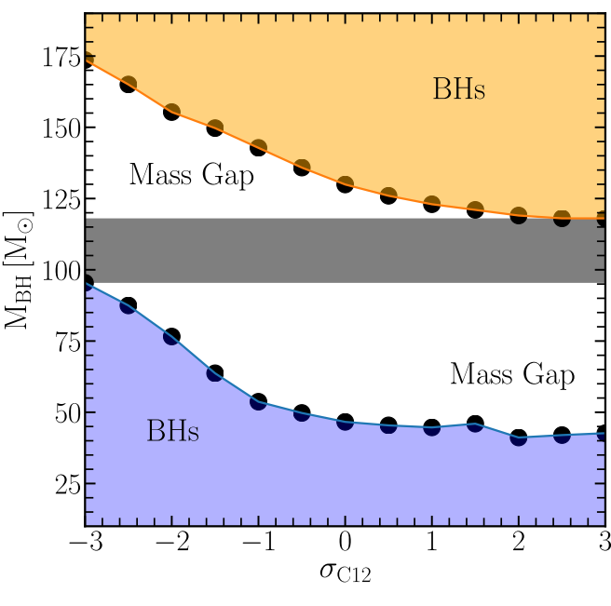
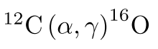


PISN gap is predicted to start above 45M$⊙$
Farag et al. 2022
Updated the C($α$, $γ$)O rates de Boer et al. (2017)
Increased mass and temporal resolution
varied triple-alpha rate
Farmer et al 2020,
(cf. Farmer et al. 2019
Renzo et al. 2020)
60-70 M$⊙$
We expect a pile-up just below this gap
cf. Mehta+ 2022, Shen + 2023, Winch + 2024
More Carbon (at the expense of Oxygen)
More Oxygen (at the expense of Carbon)
gap robust against common uncertainties: Takahashi 2018, Farmer et al. (2019/2020), Renzo et al. (2020), ﻿Marchant & ﻿Moriya (2020)
Notes:
Firstly, the stellar models never predicted the PISN mass gap to start at 35,
This shows the edge of the PISN gap as a function of C()O rate, which has the biggest impact on its location.
You expect any pile up to occur just below this edge.
Moreover, when you use more updated rates and converged MESA models, you rather place the gap at 60!
You can push it down to 45, but definitely not to 35!

Slide 4
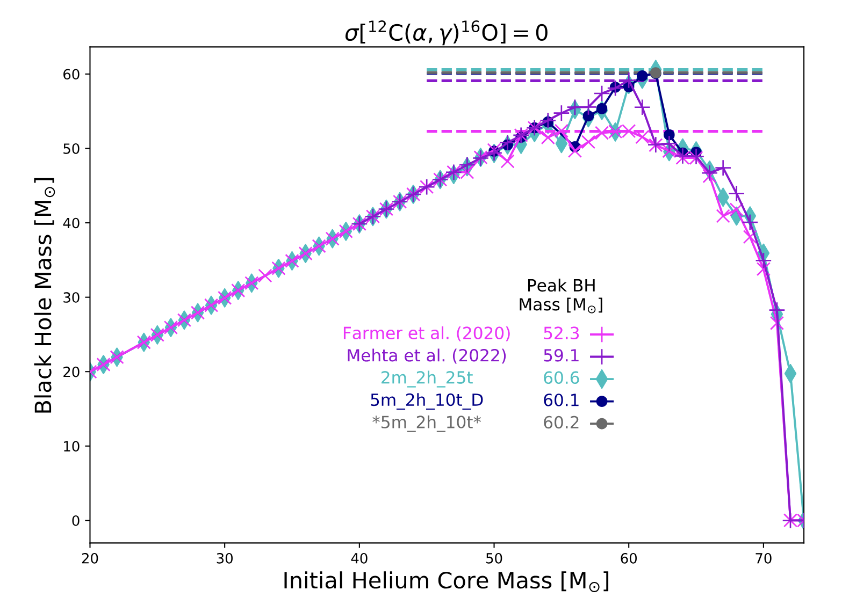
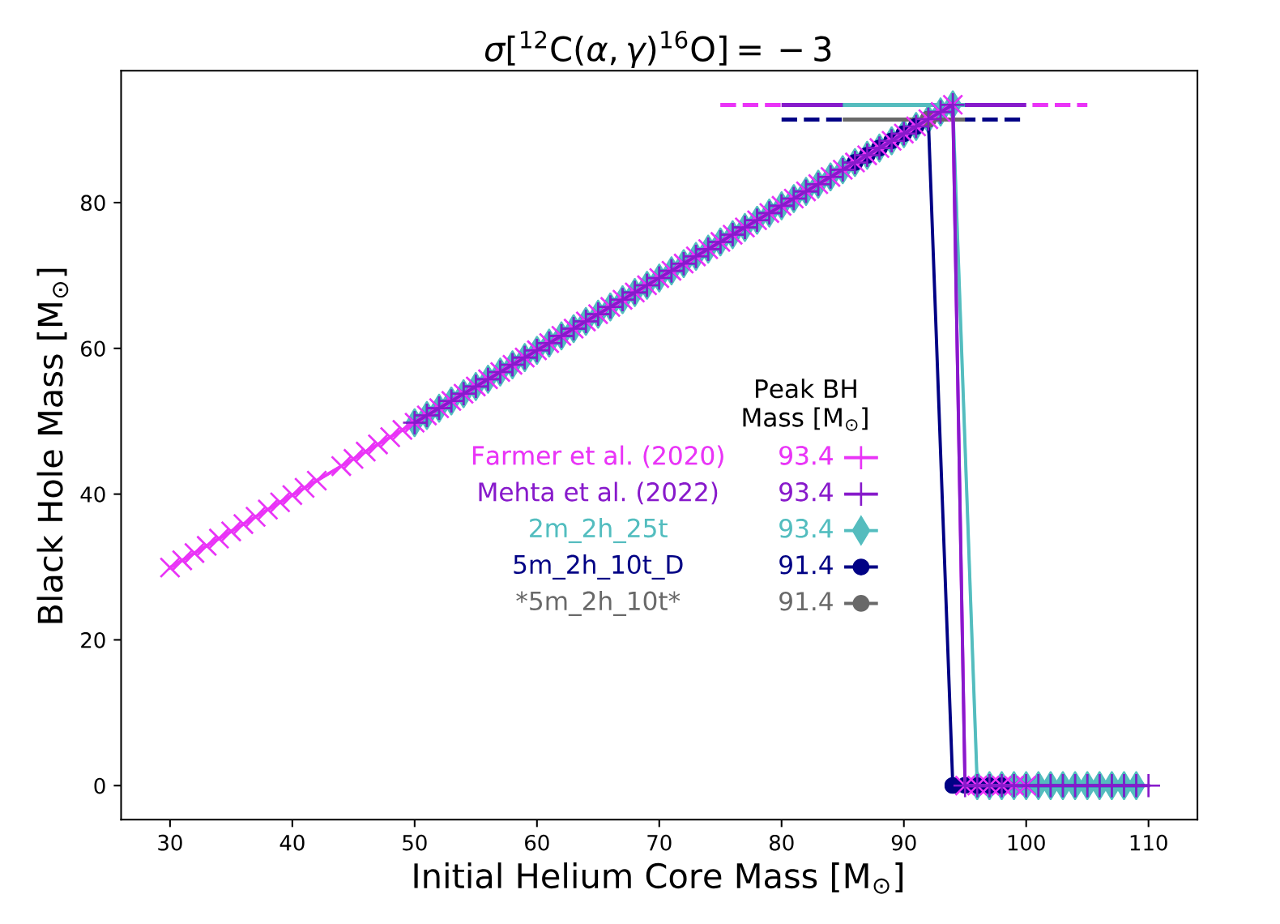
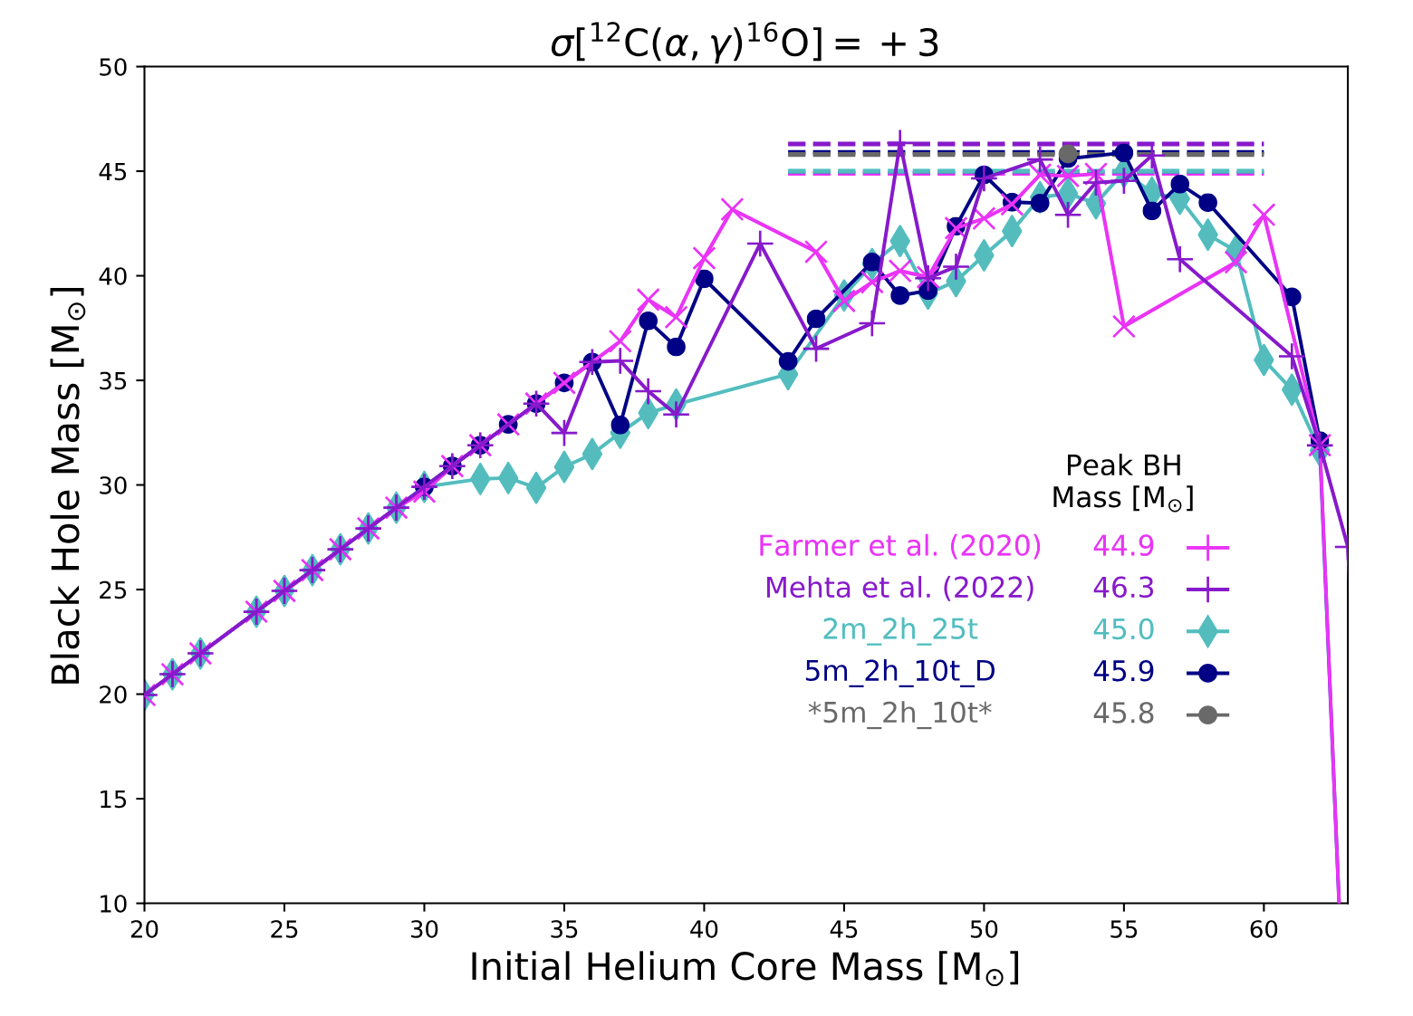
Farag +2022

Slide 5
In tension with the observed rate of hydrogen-less super-luminous supernovae
Hendriks, van Son et al. (2023)
Lieke van Son
Notes:
If you are very stubborn and you shift your C()O rates to much that they create a peak at 35Msun,
then your rate of PISN and PPISN are both in tension with the observed rate of hydrogen-less super-luminous supernovae

Slide 6
Hendriks + 2023 fiducial model

Slide 7

Pulling the PPISN edge down to 35M$⊙$
Golomb et al. 2023, using GWTC-3 data
Experimental rate from DeBoer 2017
The ¹²C(𝜶,𝜸)¹⁶O rate is far off from its experimental values!
Inferred carbon-alpha rate from 35M$⊙$ peak
S-factor for ¹²C(𝜶,𝜸)¹⁶O rate
Lieke van Son
Notes:
The same thing but then in reverse: if you infer the expected C()O rate from the GW distribution under the assumption that the 35Msun peak has to be caused by PPISN, then your rate is very far off from experimental values!
So this has led to a new game of finding 'where is the real edge of the PISN'?
Multiple people have taken a shot, O4 will give answers..!

Slide 8
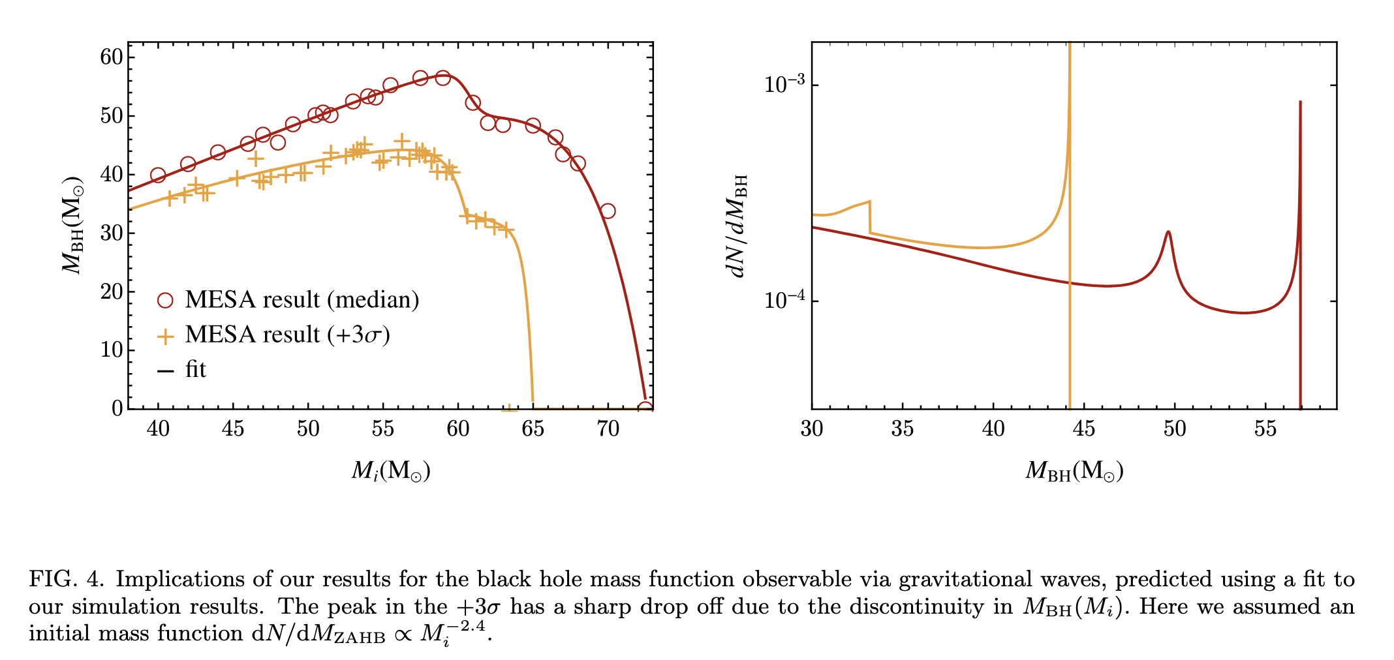
PISN scenario 2: shoulder of the PISN
Scenario:
Pre shoulder stars are hot enough to have a carbon burning shell. carbon burning releases alpha particles (He) that can partake in a bunch of alpha ladder reactions. These reactions add net energy into the stellar layers → accelerates the stellar material → makes the star easier to unbind, → mass ejection.
Bottom line: lower mass stars experience an additional phase of mass loss caused by the alpha ladder reactions in the carbon burning shell. This lowers their remnant mass, brings them to the same final mass as higher mass stars that experience more violent PISN pulses, and thus end up with lower masses, but don’t experience that second phase of mass loss because the pulses were strong enough to cool the layers that would have otherwise undergone the shell burning.
Problem with this channel: you still need +3sigma in the rate, and then shouldn’t the main pile up be much louder and thus swamp the shoulder?
Croon & Sakstein 2023

Slide 9
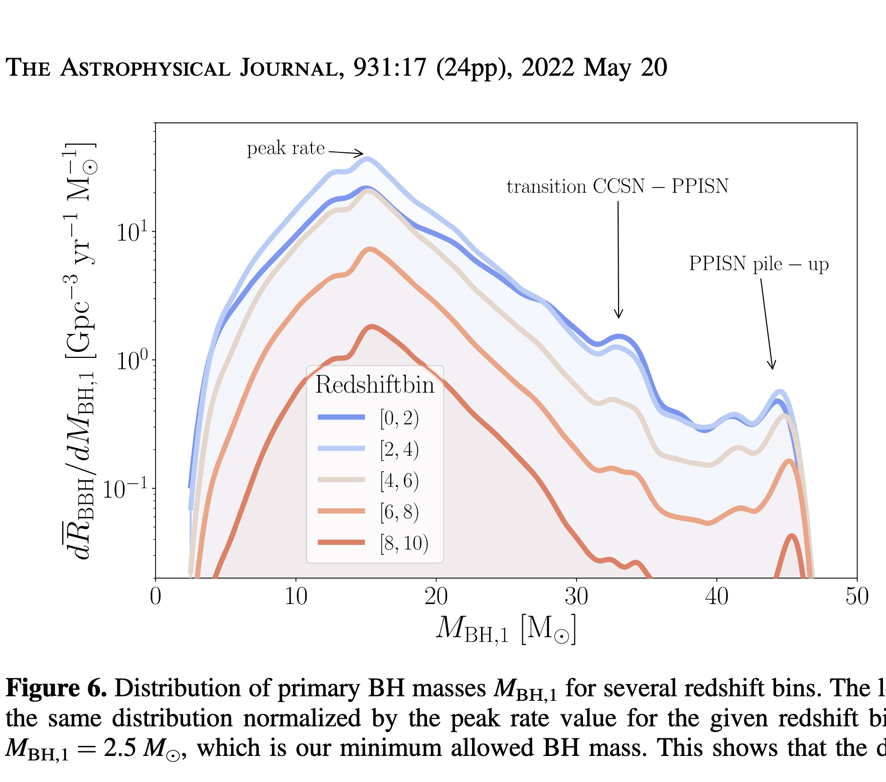
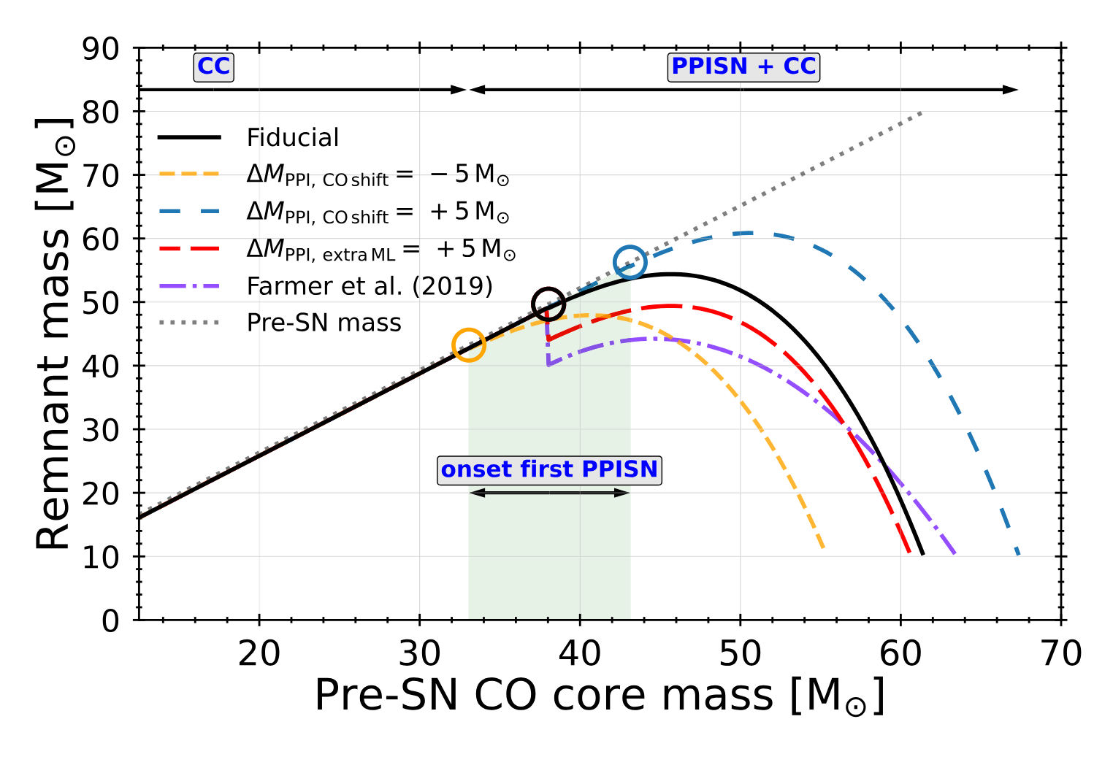
PISN scenario 3: transition CCSNe-PPISN
Van Son + 2022
Problem:
Not clear why there should be a large jump at the first pulse (see also Renzo + 2020)

Slide 10
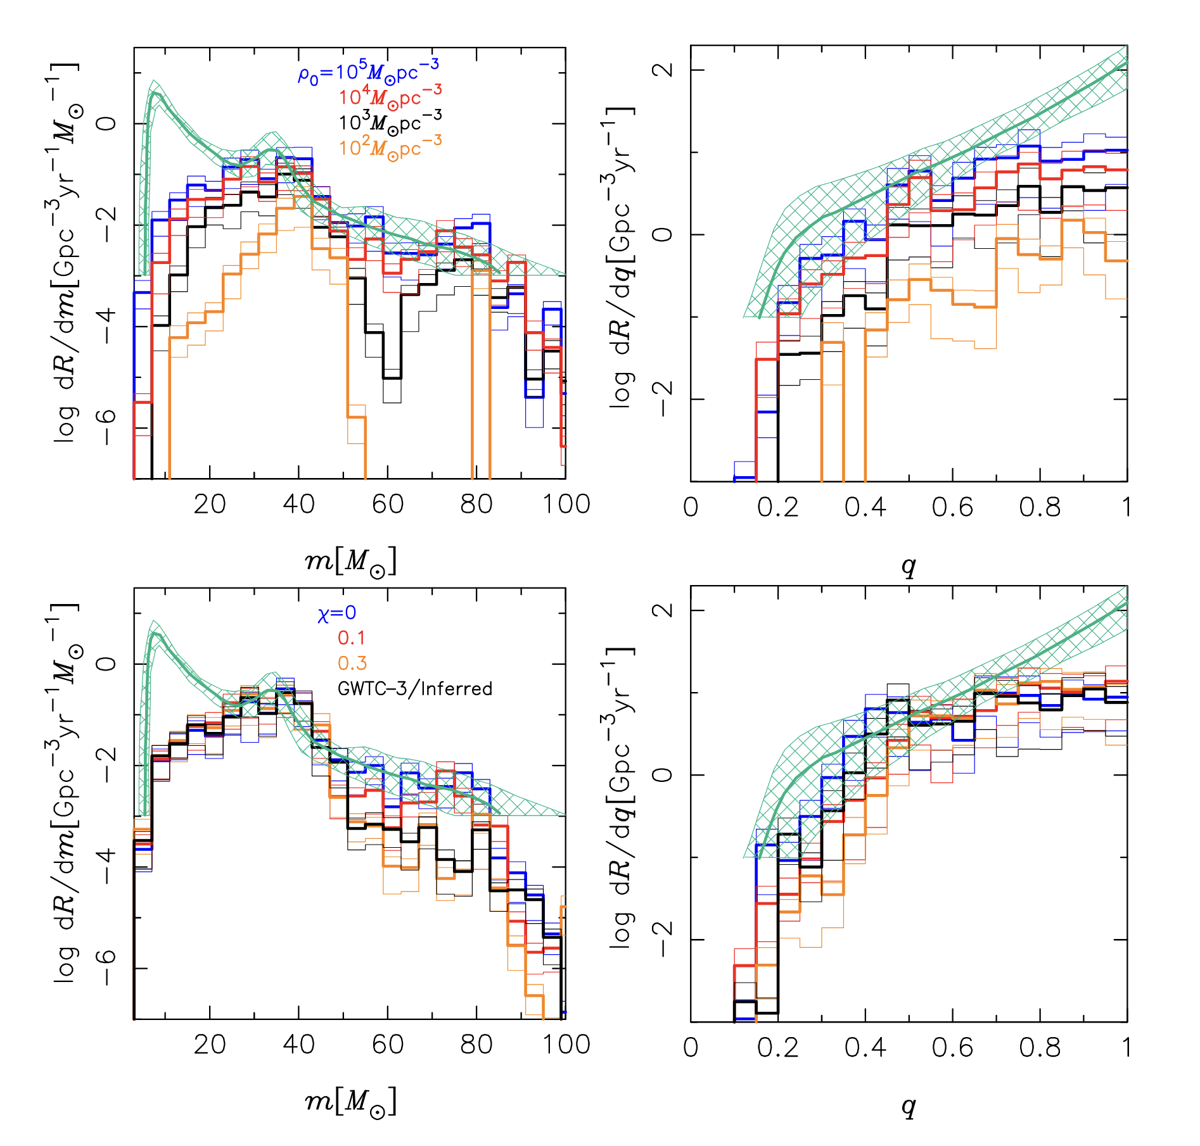
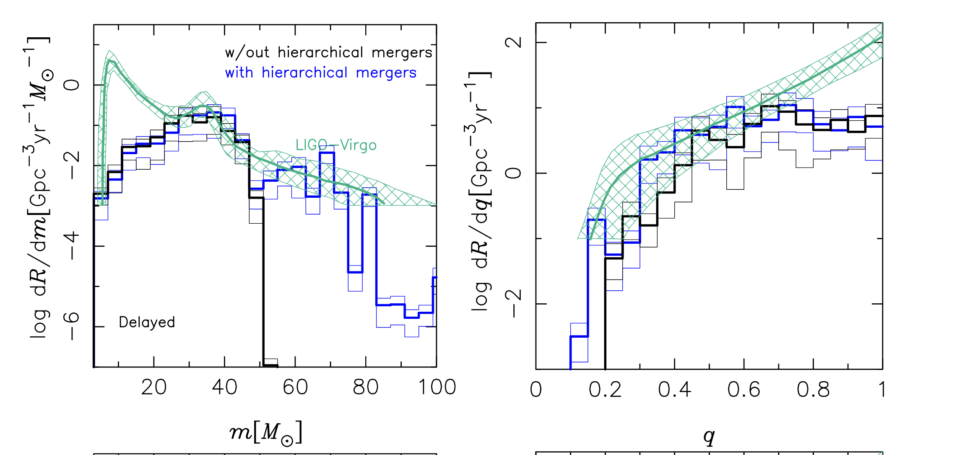
Globular clusters
Seems too broad to fit 35 bump?
Does go up at low-end :)
For some reason does Not have q ===1???
Effective spin pop should be symmetric around 0
Antonini et al 2023 https://ui.adsabs.harvard.edu/abs/2023MNRAS.522..466A
Notes:
the effective inspiral spin parameters for dynamically formed BBHs in globular clusters is expected to be more symmetric about zero than that of BBHs formed in isolation
(Mapelli et al. 2022; Chattopadhyay et al. 2023; Rodriguez et al. 2018, 2022),

Slide 11
Glob clusters cont.
Ray et al. 2024
https://arxiv.org/abs/2404.03166
Also analyze the GW data, see their section 5 for a similar “astrophysical interpretation” section, in which they conclude that Globular clusters are most likely the origin.

Slide 12
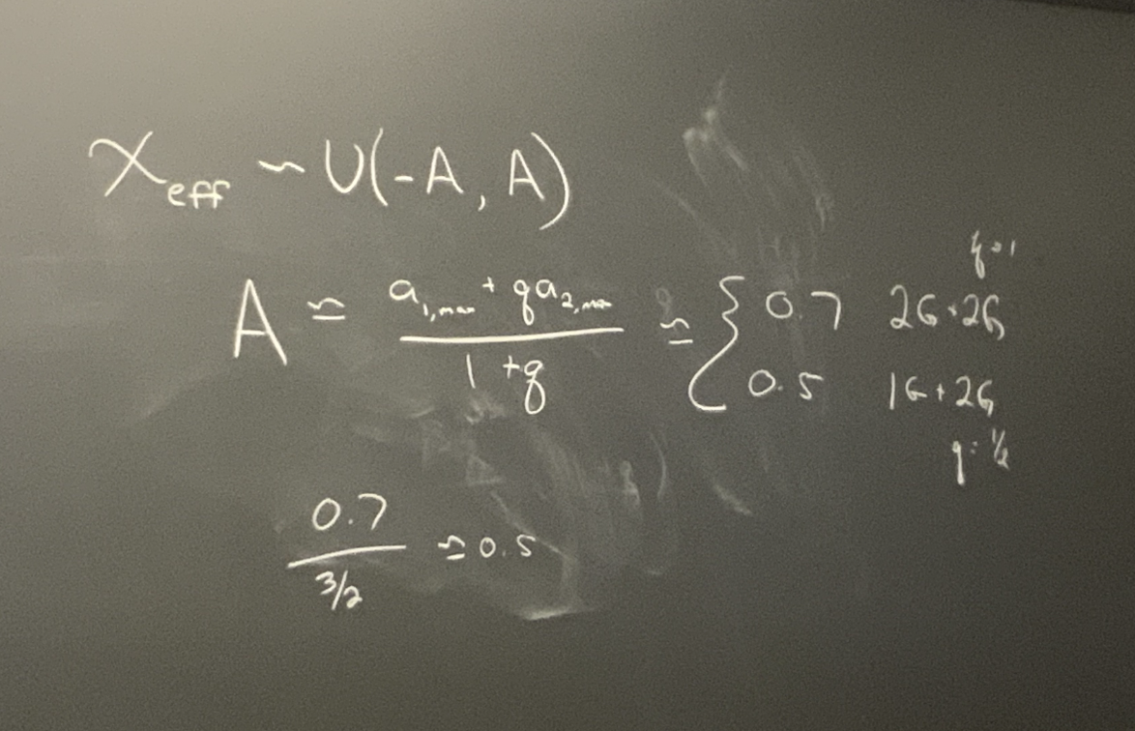
Hierarchical mergers
Suggested by e.g. Tiwari & Fairhurst 2021
Schneider et al. compactness peak at 14? Combinations like
(14 + 14) + 9 = 1G + 2G q ~0.5
(14 + 14) + (14 + 14) = 2G + 2G q = 1
Doesn’t seem to be the case because most systems are equal mass, and that would have to be 2G + 2G
Note: If you believe our mass model, some systems are inevitably pushed to unequal mass.. these unequal mass systems could have a big sigma_chi eff so that we cannot exclude a sub-population of hierarchical mergers living in the peak.
Notes:
Tiwari, Vaibhav ; Fairhurst, Stephen

Slide 13
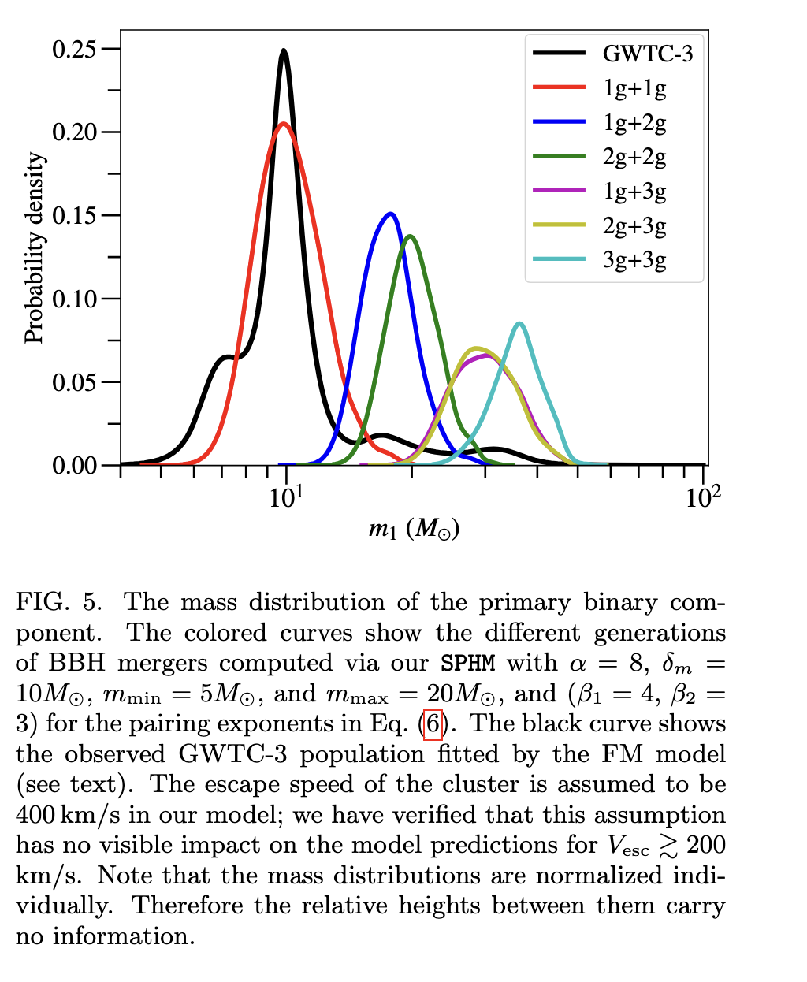
More hierarchical
Mahapatra et al 2025
https://ui.adsabs.harvard.edu/abs/2025PhRvD.111b3013M/abstract
``The occurrence of multiple peaks in the mass spectrum is attributed to the different merger generations within the hierarchical merger scenario”
Assuming the pair- ing function of Eq. (6), we find that 87% of the 1g+1g BBHs have primary masses between 5M⊙–13M⊙; 98% of the 1g+2g mergers and 92% of the 2g+2g mergers have primary masses in the range 13M⊙–25M⊙; 86% of the 1g+3g mergers,
(…) these findings strongly suggest that the multiple peaks in the observed mass spectrum could originate from different generations of mergers in high-metallicity clusters

Slide 14
AGN channel
Barry & Saavik paper: they mostly discuss the 35 Msun peak as a possible source for the “70Msun peak” observed by Magana Hernandez & Palmese 2024
It doesn’t seem like they intrinsically predict a 35Msun peak for any reason directly from the AGN channel
Notes:
My thoughts:
Main idea of channel:
If Pop III stars have < 50Msun, they evolve to blue giants, and the stellar radius does not enlarge so much, indicating that close binaries are more likely to coalesce.
(e.g. Kinugawa et al. 2014; Inayoshi et al. 2017; Tanikawa et al. 2021a)
I always wondered how these stars can be born so close together, seems like they tried to address that: https://arxiv.org/pdf/2305.06843
In Kirihara + 2023 they note: “We conclude that there must be some orbital shrinking mechanism after the protostars contract to enter the zero-age main-sequence stage.”
In Kinugawa + 2021 https://arxiv.org/pdf/2103.00797
They do some weird trick to fit the q for observed BHBH masses, and then conclude that this line fit matches their pop III stars:
“Therefore, the relation of M2 = 0.673M1 is consistent with Pop III star origin.”

Slide 15
CHE stars 1: pure
Lucas de Sa + in prep ☺

Slide 16
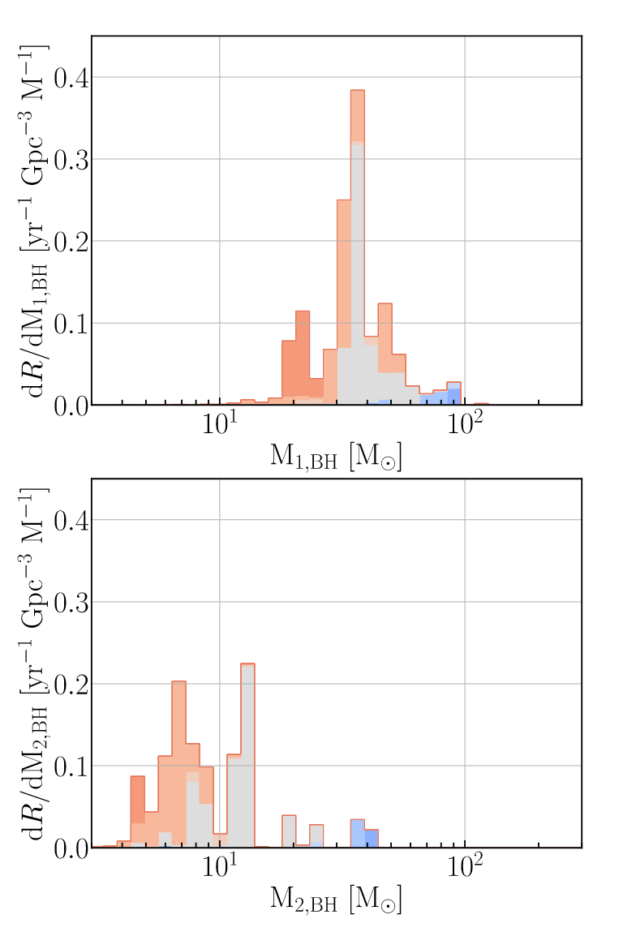
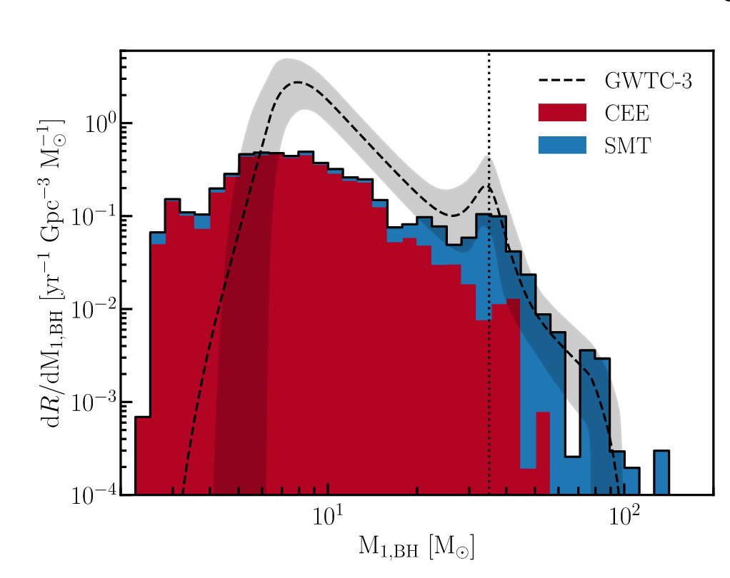
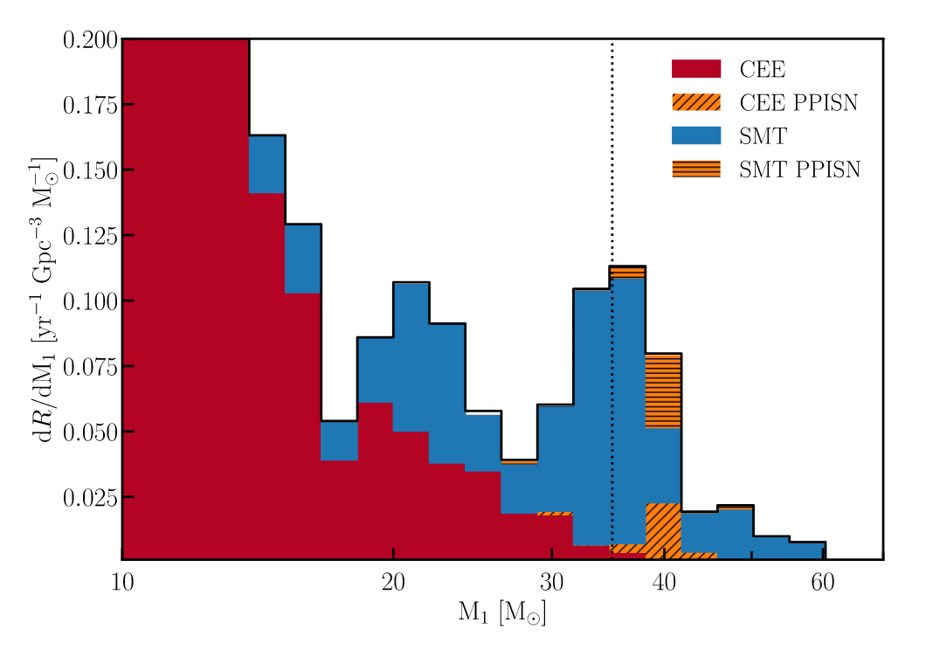
CHE stars 2: quasi CHE + super eddington
SMT + SMT
Briel et al. 2023
They put in a lot of effort to understand the origin of these systems around 35Msun. They find its SMT + quasi CHE (which I think would lead to m2 spinning), and SMT + SMT, which I think end up with low mass ratios of q~0.3 given fig. 10 , and Fig. 15
Notes:
we find that in BPASS the 35 M excess is not due to pulsational pair-instability, as previously thought, but a feature caused by stable mass transfer, whose regime is limited by the mass transfer stability, quasi-homogeneous evolution, and stellar winds.
They make a BIG effort

Slide 17
CHE models
Winch 2025 paper

Slide 18
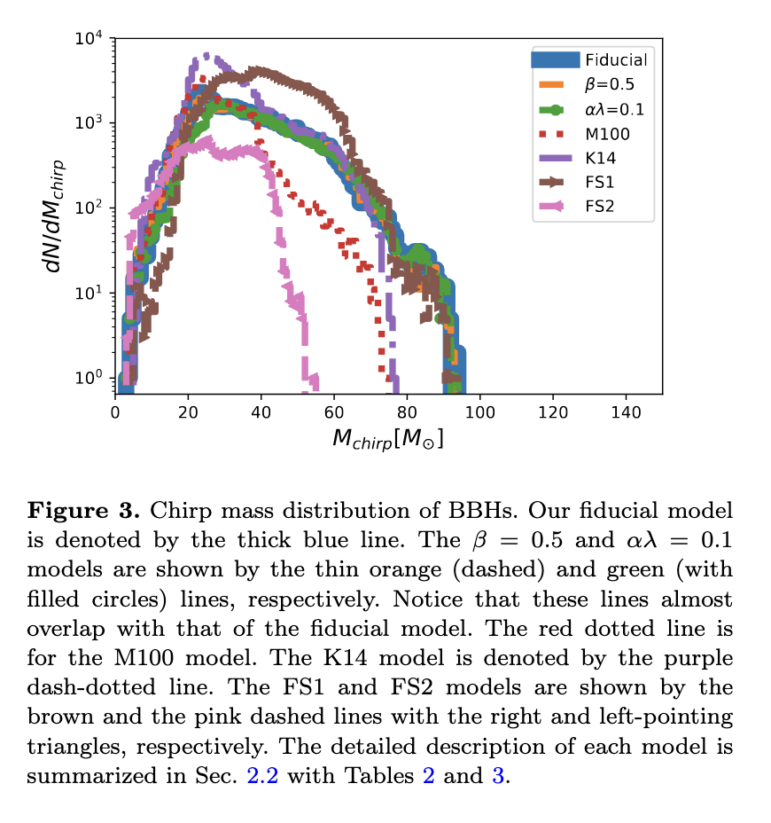
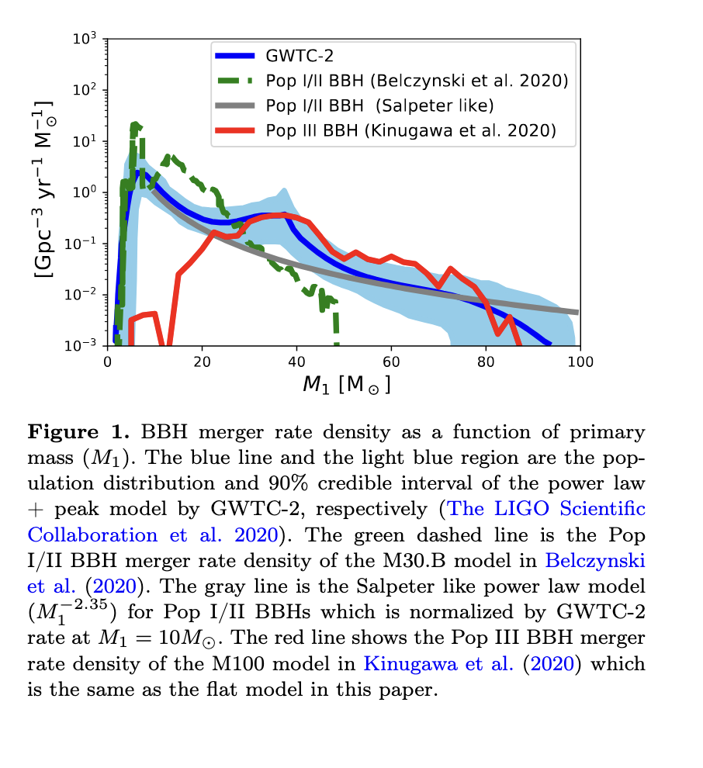
Population III stars
Thoughts:
IMF is flatter, stay small stars (due to no metals). If M<50Msun, they become BSG that do stable mass transfer (which leads to more massive BHs??)
<chi_eff> = low at low redshift but high at high redshift. This is caused by the birth separation: all are born at ~same time. Those with wide separations don’t do tidal spin up and have long tdel = merge today. Those with short sep. = yes tidal spin up = merge at high z
Their feature is Not sharp (see fig. 1)
Our very equal mass finding seems inconsistent with their m2 = 0.7 m1 (from Kinugawa21)
I always wondered how these stars can be born so close together, seems like they tried to address that: https://arxiv.org/pdf/2305.06843
Kinugawa + 2020 https://arxiv.org/abs/2005.09795 If the BBH chirp mass distribution has bimodal peaks at ∼ 10 M and at ∼ 30 M which might be suggested by Fig.1, the massive peak might be made from Pop III sources. For the spin of BBH mergers, Pop III BBH mergers at z ∼ 0 tend to have low spin parameters χi. This feature is consist with the aLIGO/aVIRGO analysis. On the other hand, Pop III BBH mergers at the high redshift parameter tend to have high spin parameters χi.
Kinugawa + 2021 https://arxiv.org/abs/2103.00797 Population III stars in the form of f(M)∝M−α, population synthesis numerical simulations with 0≤α≤1.5 are consistent with O3a data for Mc≳20Msun
Notes:
My thoughts:
Main idea of channel:
If Pop III stars have < 50Msun, they evolve to blue giants, and the stellar radius does not enlarge so much, indicating that close binaries are more likely to coalesce.
(e.g. Kinugawa et al. 2014; Inayoshi et al. 2017; Tanikawa et al. 2021a)
I always wondered how these stars can be born so close together, seems like they tried to address that: https://arxiv.org/pdf/2305.06843
In Kirihara + 2023 they note: “We conclude that there must be some orbital shrinking mechanism after the protostars contract to enter the zero-age main-sequence stage.”
In Kinugawa + 2021 https://arxiv.org/pdf/2103.00797
They do some weird trick to fit the q for observed BHBH masses, and then conclude that this line fit matches their pop III stars:
“Therefore, the relation of M2 = 0.673M1 is consistent with Pop III star origin.”

Slide 19
From Kinugawa 2020

Slide 20
Dear Soumendra Roy,
Thank you very much for your very interesting and inspiring presentation the other day. I truly enjoyed it and learned a lot.
Apologies for the delayed email — I should have written to you sooner.
Let me briefly introduce myself. My name is Tomoya Kinugawa. I am the first author of a paper on Population III star-origin binary black holes, written together with Kenta. You can find the paper here: https://ui.adsabs.harvard.edu/abs/2014MNRAS.442.2963K/abstract In this work, we showed — even before the first gravitational wave detection — that Population III stars typically form binary black holes with masses around 30 solar masses, which merge within the detection range of LIGO.
We also published a follow-up study in 2020, where we updated the model and predictions: https://ui.adsabs.harvard.edu/abs/2020MNRAS.498.3946K/abstract In this paper, we performed a detailed calculation of the mass and spin distributions of binary black holes originating from Population III stars. We found that the spin distribution is closely related to the merger time: systems with longer merger times tend to have lower spins, while those with shorter merger times tend to have higher spins due to tidal interaction. As a result, mergers detectable by LIGO are expected to have low spins, whereas high-redshift mergers observable by future detectors like the Einstein Telescope (ET) are predicted to have higher spins.
In addition, we published another paper in 2021: https://ui.adsabs.harvard.edu/abs/2021MNRAS.504L..28K/abstract In this work, we showed that binary black holes originating from Population III stars provide a good explanation for the high-mass region observed in LIGO's gravitational wave detections.
I’d be happy to hear your thoughts if you happen to take a look.
Best regards, Tomoya Kinugawa

